Slide 1

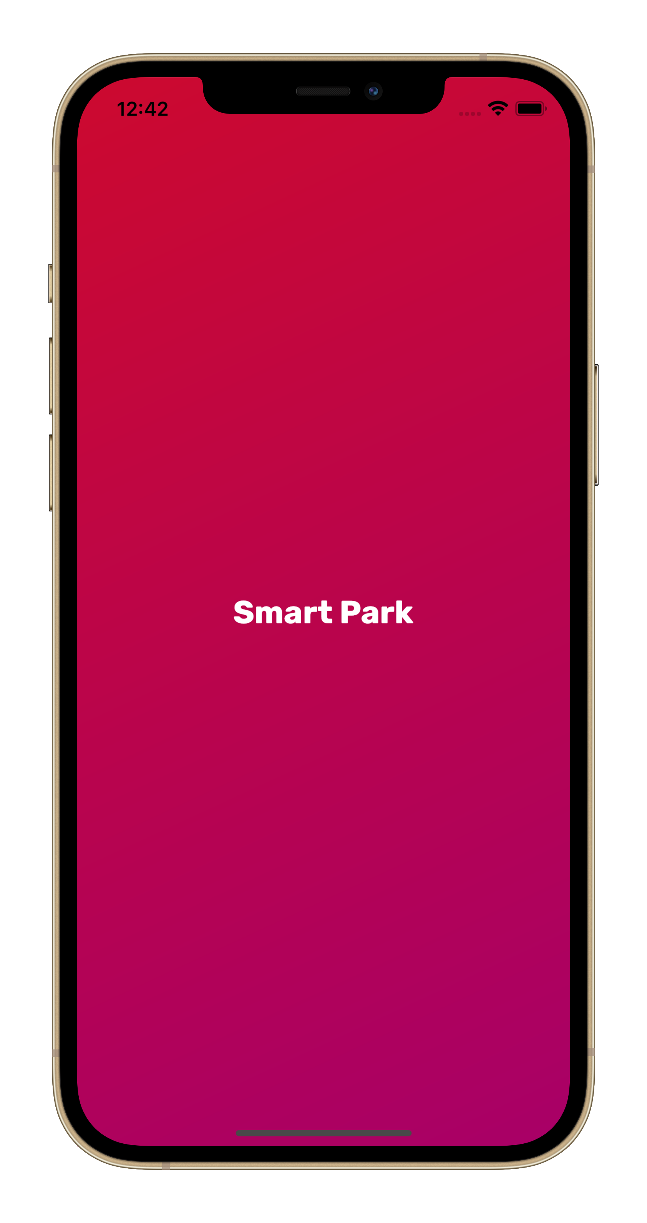
SMART PARK – a MACHINE LEARNING PARKING APPLICATION
By: AUSTIN SMITH, VU NGUYEN, JAGGER HARNESS, HEMIL PATEL
MENTOR: CHRISTOPHER SALDIVAR

Slide 2

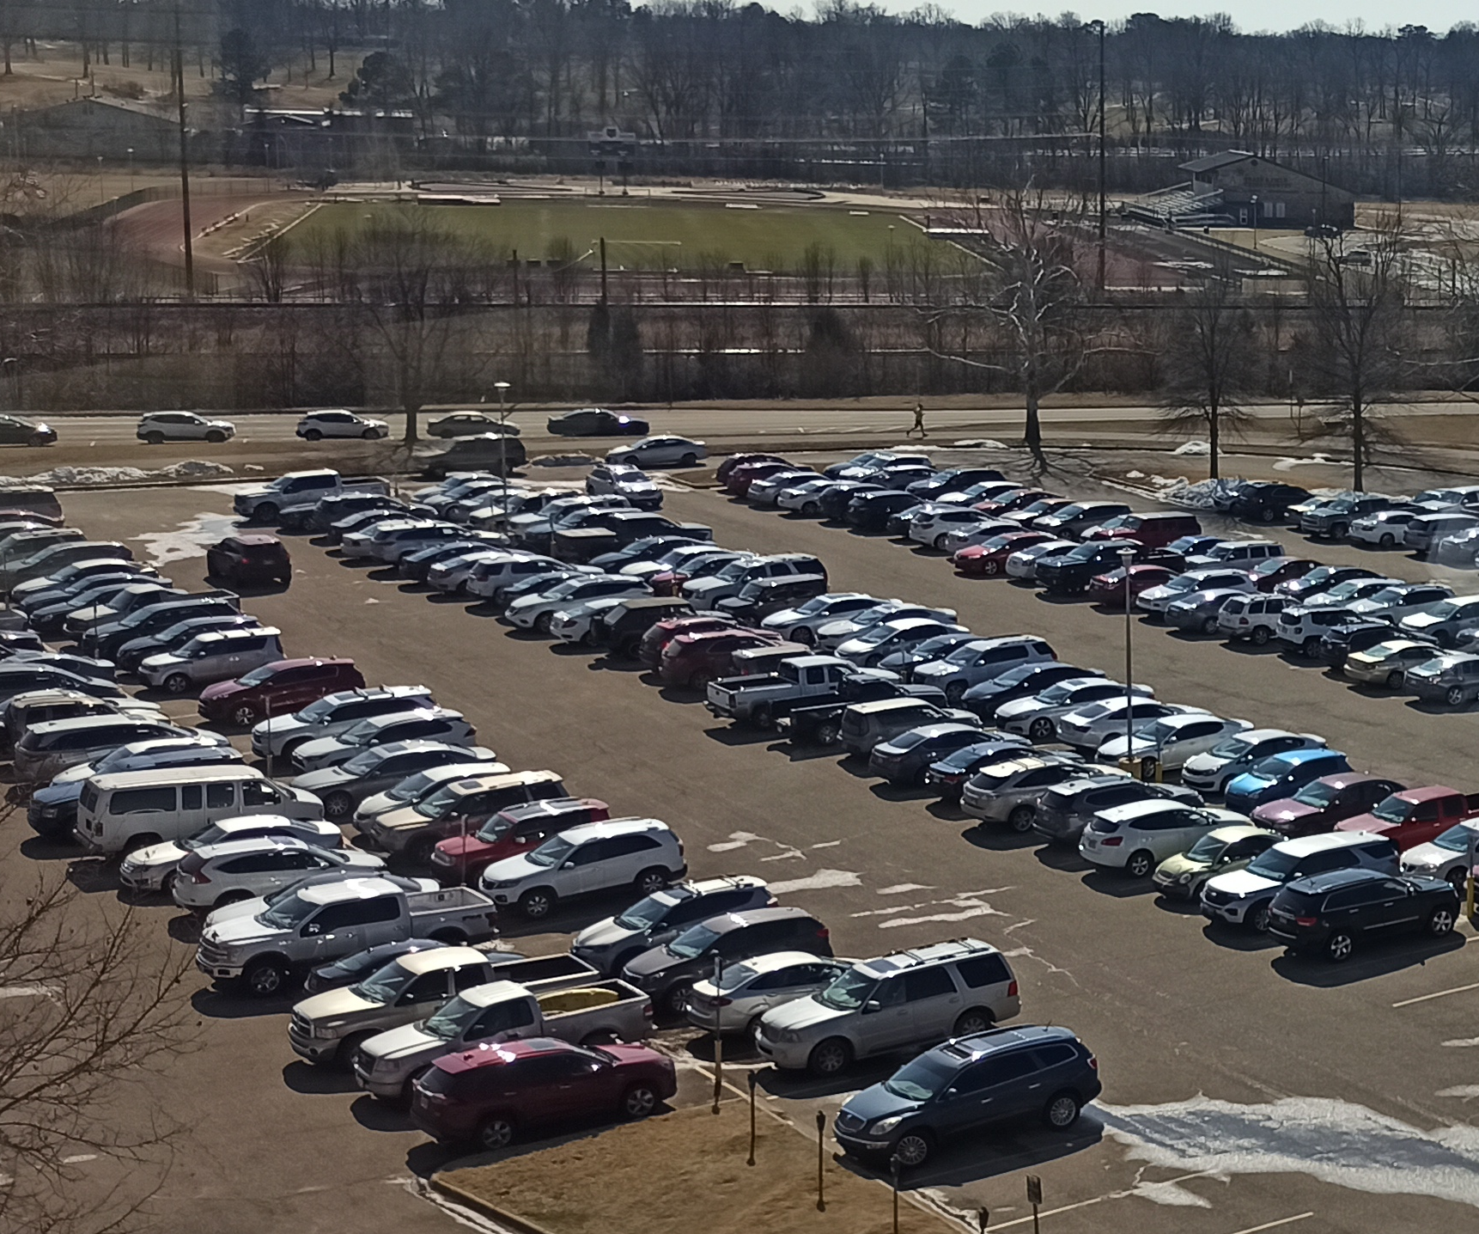
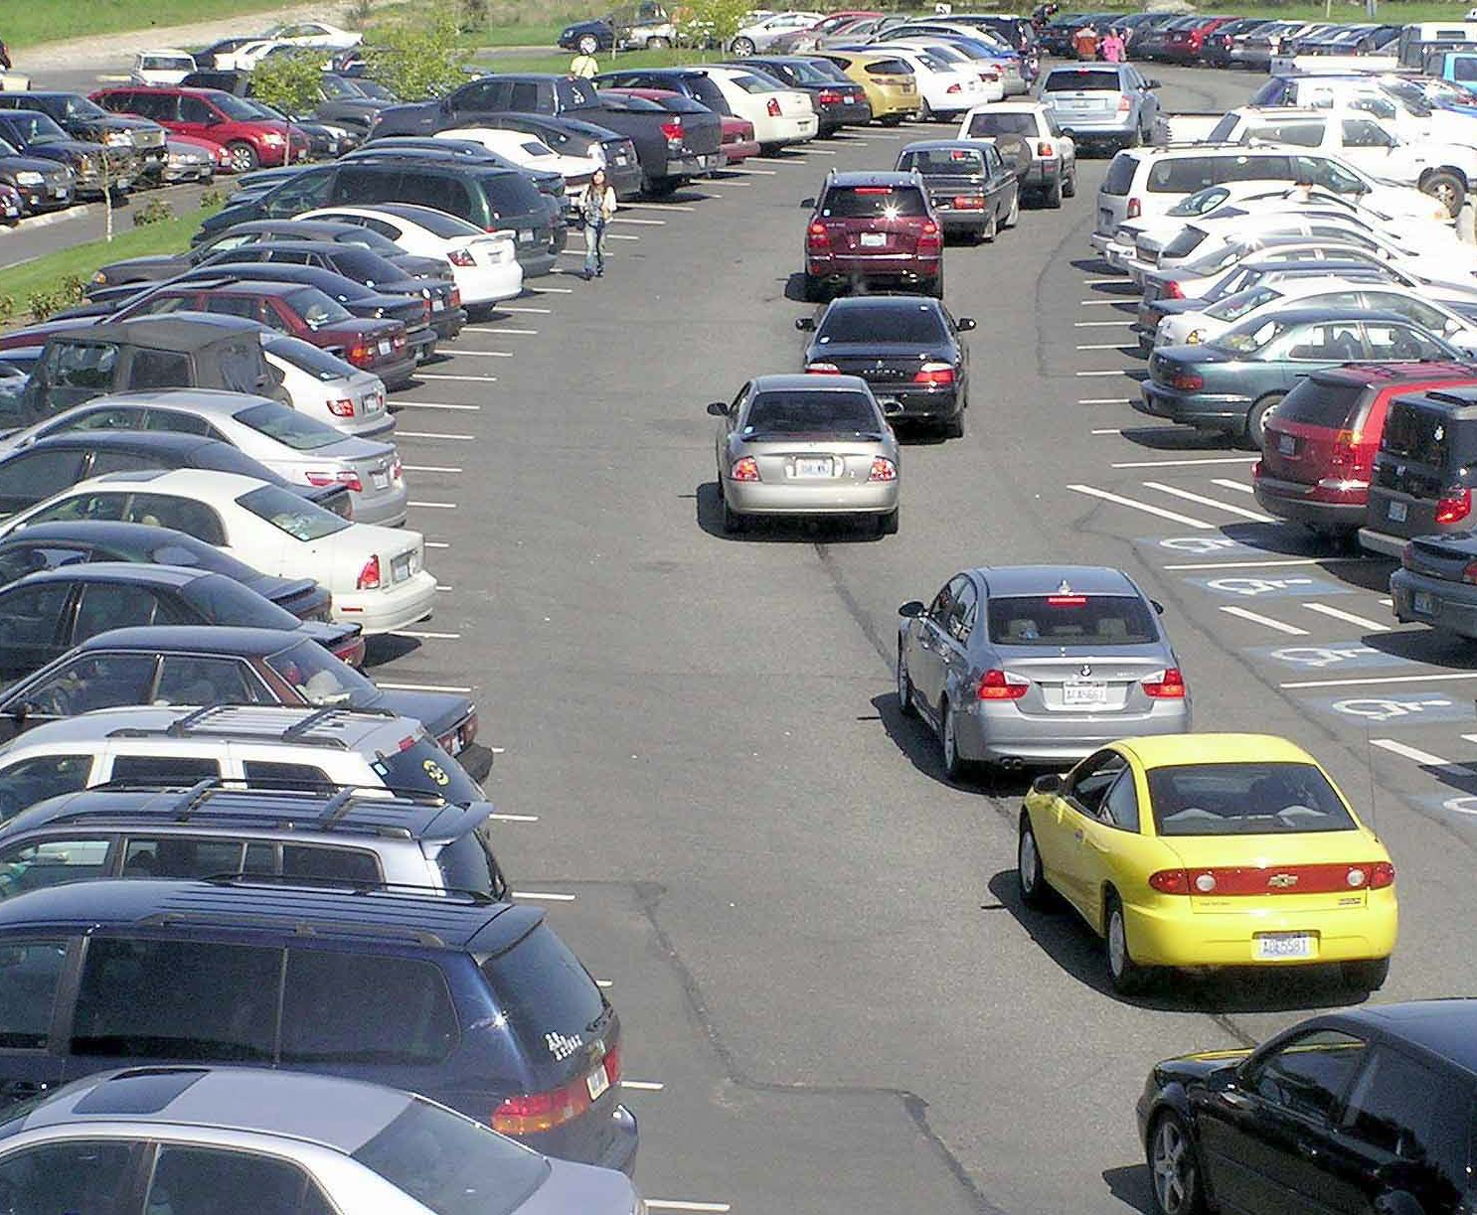
PROBLEMS - INSPIRATION
The congestion in the parking lots has been a known problem in high traffic areas.
University parking lots are not exceptions.
A-State campus parking has been proven difficult.

Slide 3

PROBLEMS - INSPIRATION
Drivers wasting time circling around to find a vacant spot.
Everyone might be late for work or classes if they don’t come early.
Drivers wish to know where they will park before arriving.

Slide 4
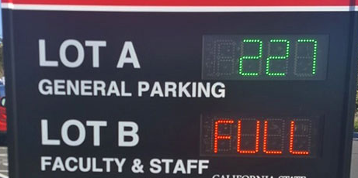
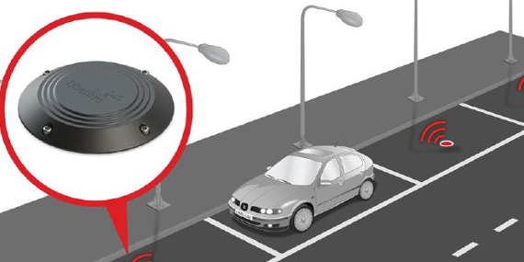
PROBLEMS - INSPIRATION
Common solutions to reduce parking lot traffic:
Expensive.
Cannot provide the location of vacant spaces.
Require high maintenance.

Slide 5
idea of a parking space detection system using DEEP LEARNING
Image Classification Model
Determine the space status:
EMPTY or OCCUPIED
Web Server/
Database
Store parking spaces data
Mobile Application
Allow users to verify slot availability in real-time

Slide 6
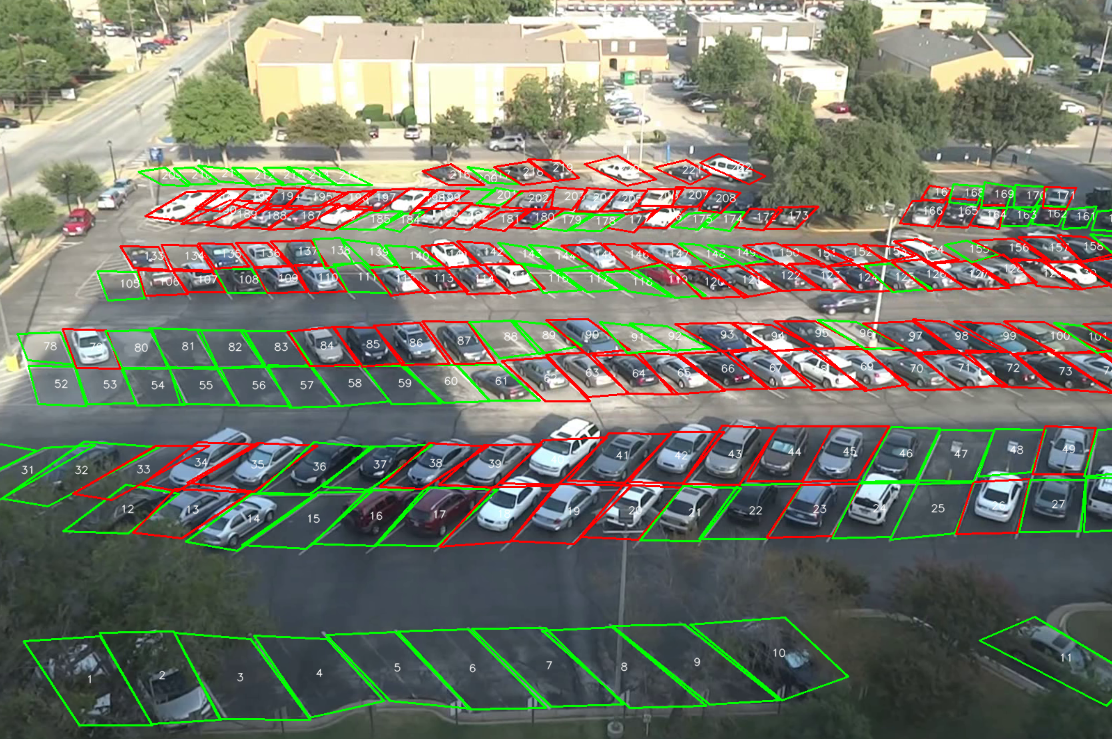


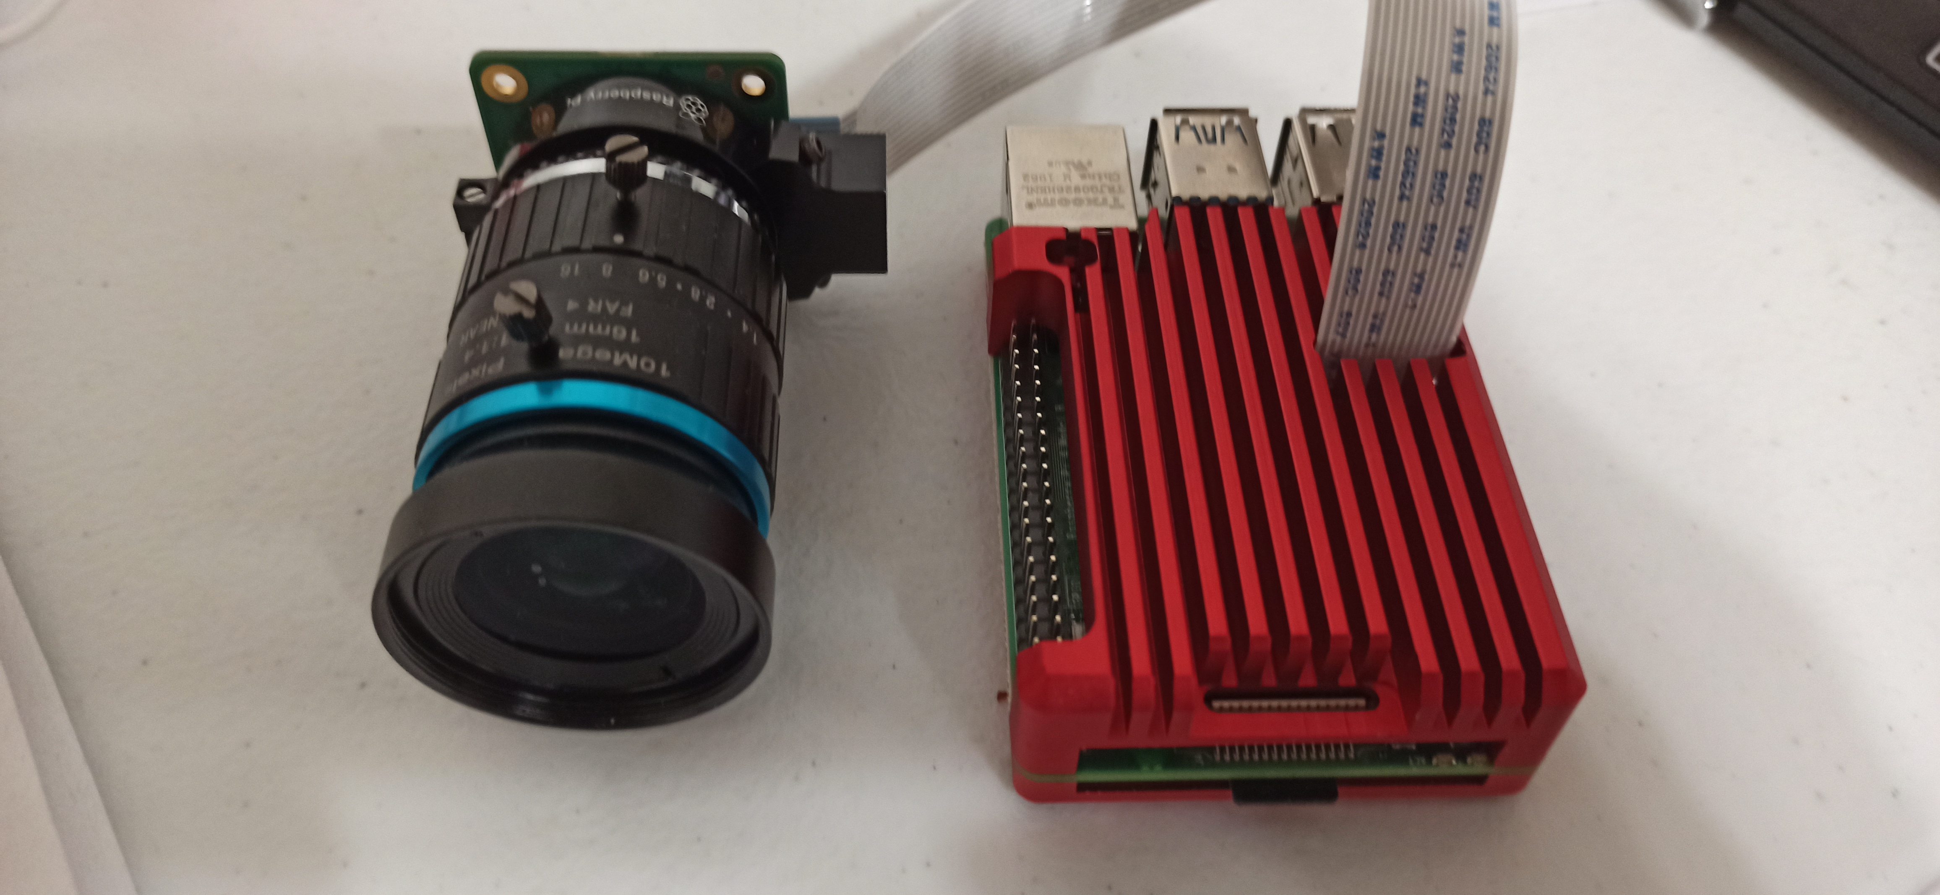
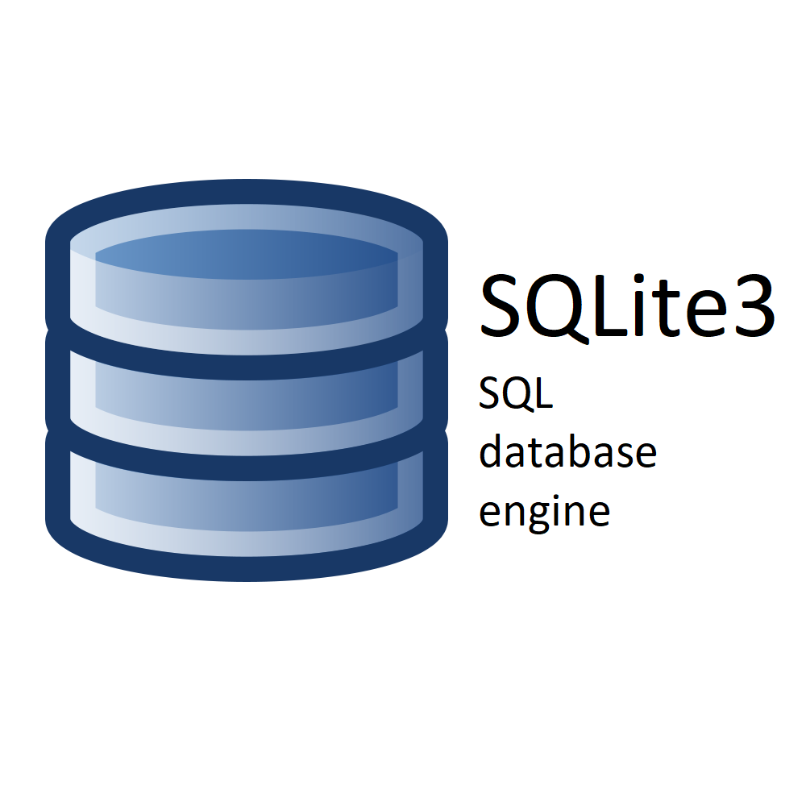
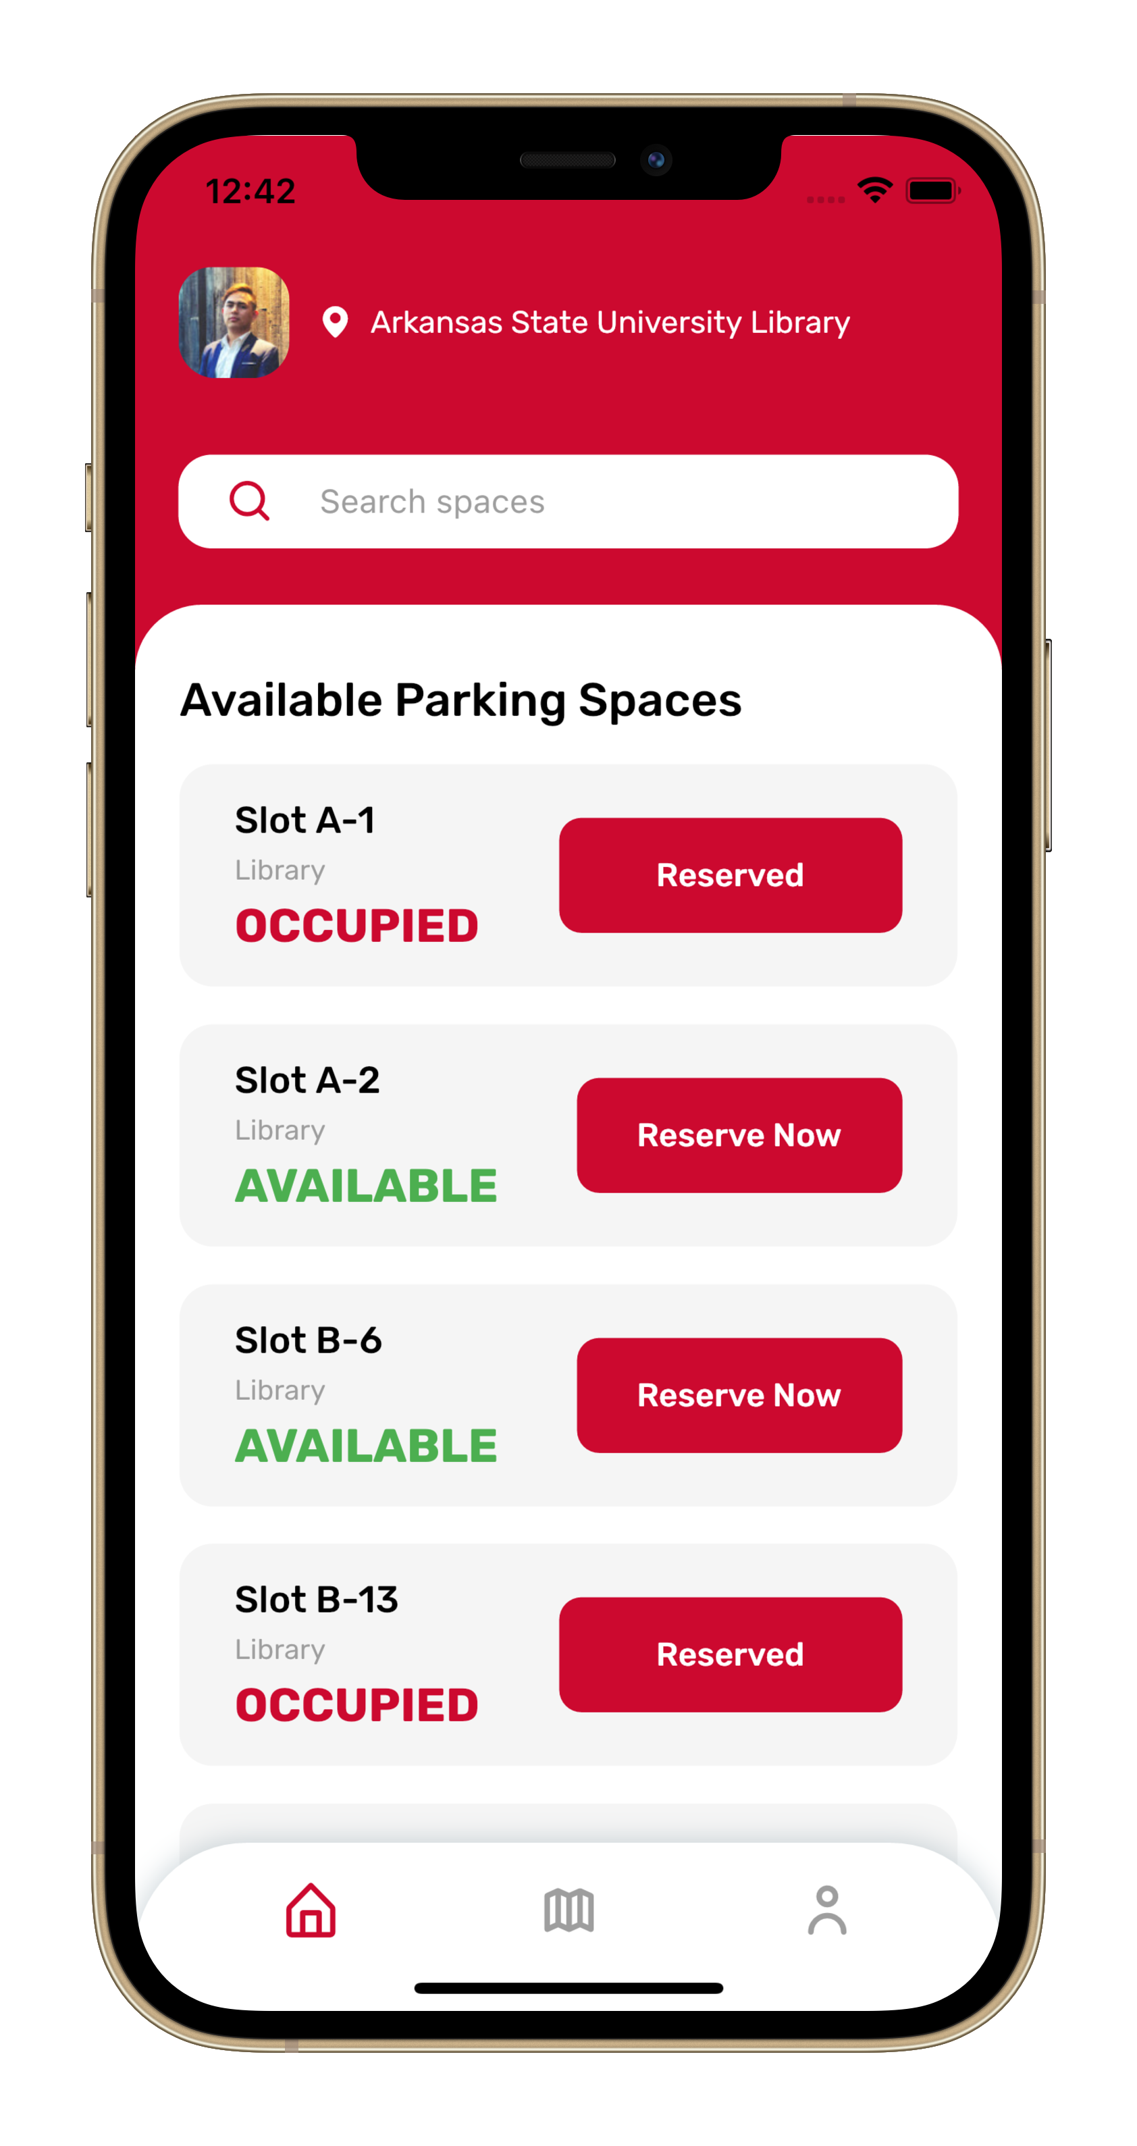
[ Occupied, Empty ]
Raspberry Pi 4
Image classification Model
Backend Server
System Flow
Parking spaces database

Slide 7
RASPBERRY PI CAMERA
The parking space detection system was built with main components:
Raspberry Pi 4 [1] and camera wide-view lens to deploy the model.
Placed on a high location such as a roof of a building.
TensorFlow Lite model installed.

Slide 8
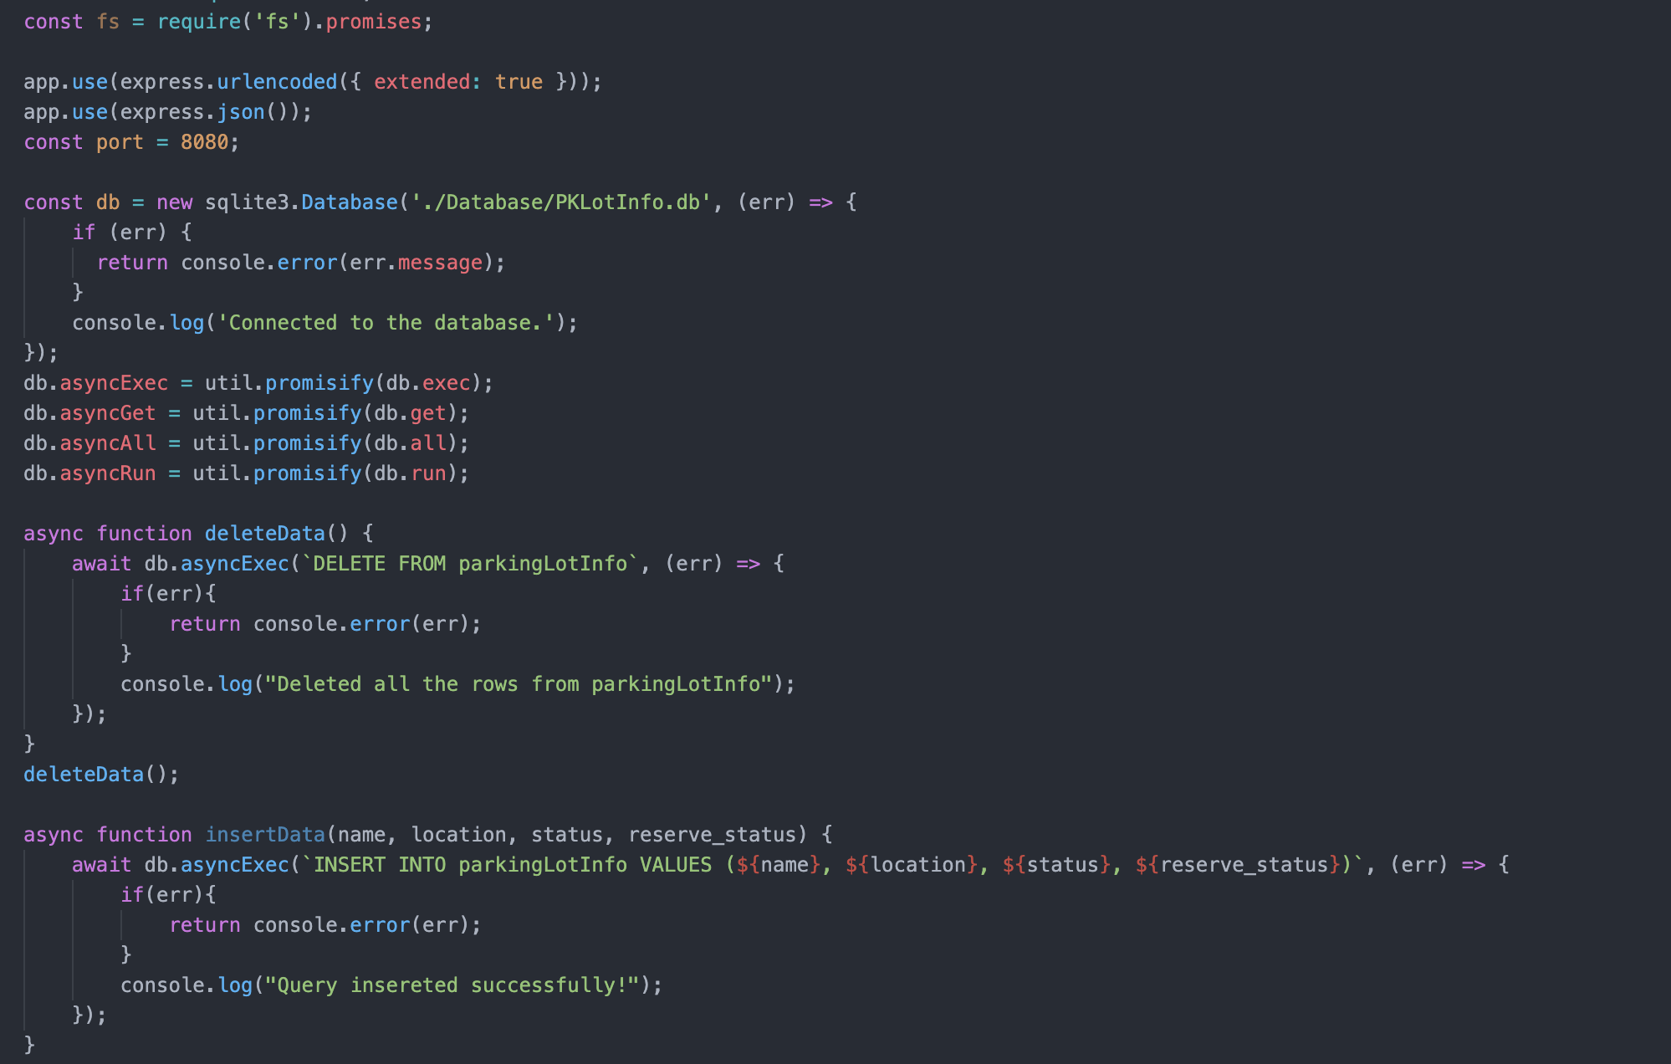
WEB server & database
Backend web server was implemented as a RESTful API [4] using Node.js framework [5] with JavaScript programming language [6].
Receiving spaces’ status data from the classifier model and store it into a database.
Syncing data to the mobile application in real-time.

Slide 9
WEB server & database
All parking spaces’ data is stored in a relational database using SQLite3 [7].

Slide 10
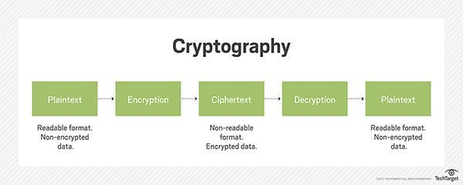
cryptography
Cryptographic technique is to secure communication between server and machine learning model.
Cryptosystems use a set of procedures known as cryptographic algorithms to encrypt and decrypt messages between computer systems, smartphones, and applications.

Slide 11
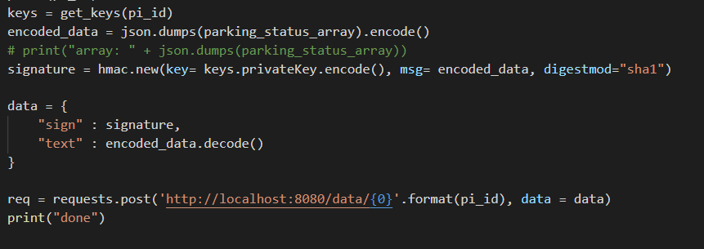
KEY AND SIGNATURES
Cryptography allows the data to be signed which essentially makes it tamper-proof.
In this case, we utilized keys and signatures to ensure that the data being sent to the web server and database was from the unique Raspberry Pi and not an outside source.

Slide 12
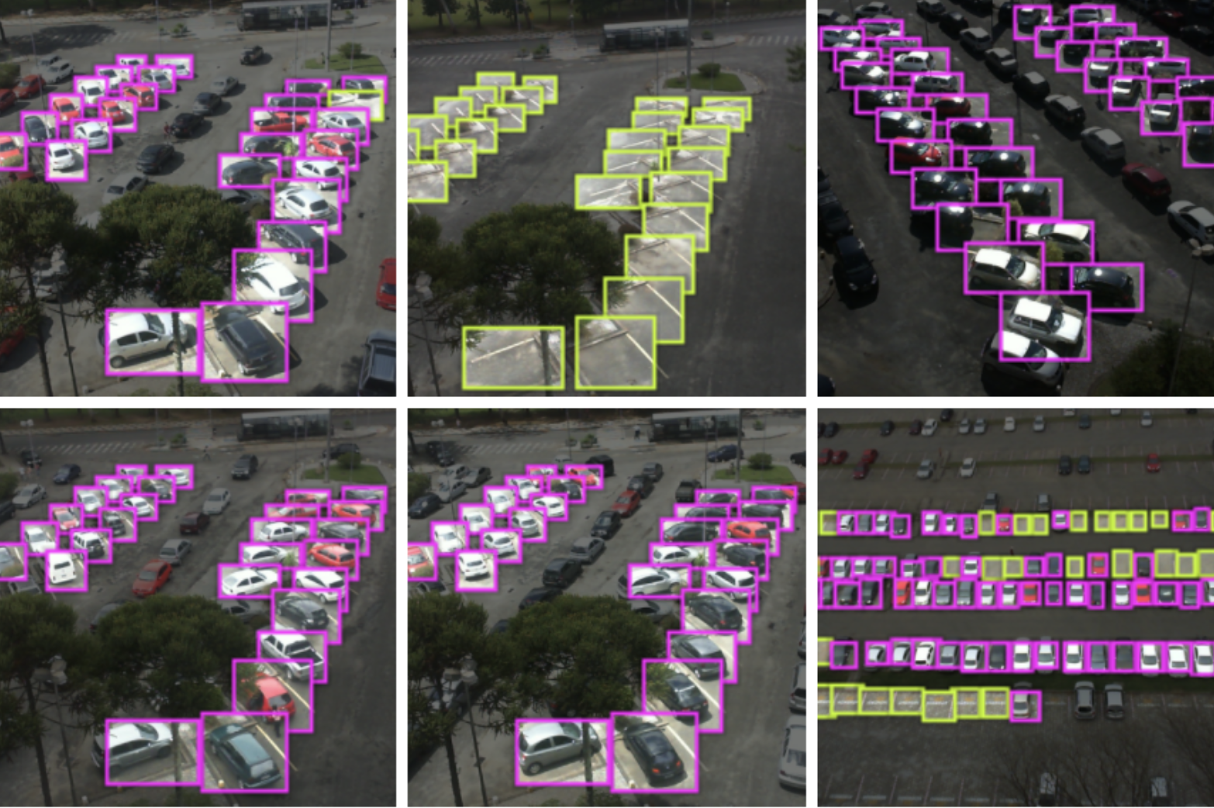
Parking space classifier model
The model was trained using “PKLot – A robust dataset for parking lot classification” [3].
Consisting of 695,899 images.
Captured from two parking lots with different camera views.
Under different lighting and weather conditions.

Slide 13
Parking space classifier model
When being tested at a parking lot with 222 spaces being observed:
The model achieved an accuracy of 85%.
Precision is 73%.
Recall is 88% which is the proportion of actual vacant slots identified correctly.

Slide 14


SMART PARK APPLICATION
Smart Park mobile application was built by Flutter framework [8] with Dart programming language [9] to run on Android [10] and iOS [11] platforms.
Providing multiple functionalities to help parking more convenient.
Receiving data sent from the machine learning model via web server.

Slide 15
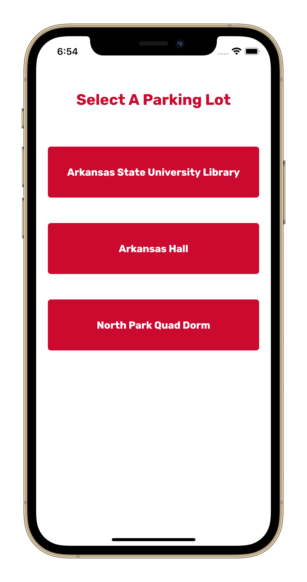
Parking lots near me
The app will suggest to users a list of parking lots nearest to the users’ current location.
Device GPS location is collected to calculate the distance between the current location and parking lot location data in the database.
Users select one parking lot to see the availability of its parking spaces.

Slide 16
LIST VIEW MODE
Parking spaces’ availability is displayed on a list to create an intuitive user interface.
Users can refer to see parking space real-time status.
Users can also reserve a parking space for a certain amount of time in advantages.

Slide 17
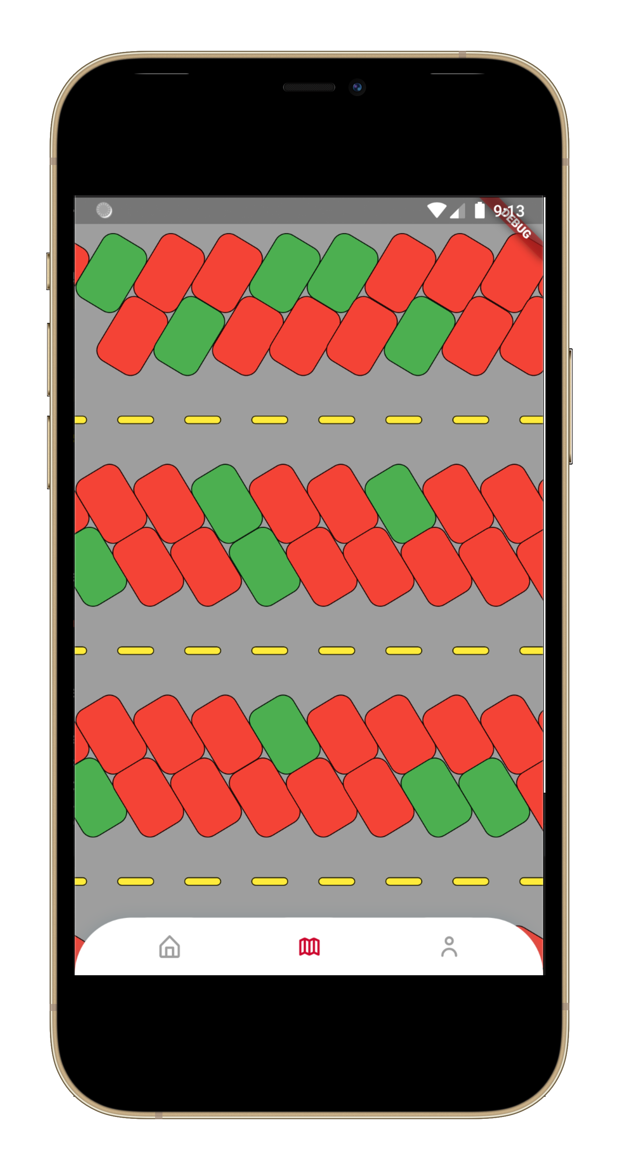
MAP VIEW MODE
Map view mode helps users locate a parking space faster with the directions and the color indicator for space status.
Map view layout was rendered using the coordinates detected from the camera.

Slide 18
Why smart park?
Saving time to find, quickly navigate to the open parking slot.
Students, faculty and visitors can avoid being late from circling the parking lot.
The university can improve the parking experience
Low cost
Comparable accuracy
Easy to set up
The solution can be applied not only at the university parking lot but also for public parking lots to reduce traffic congestion.

Slide 19
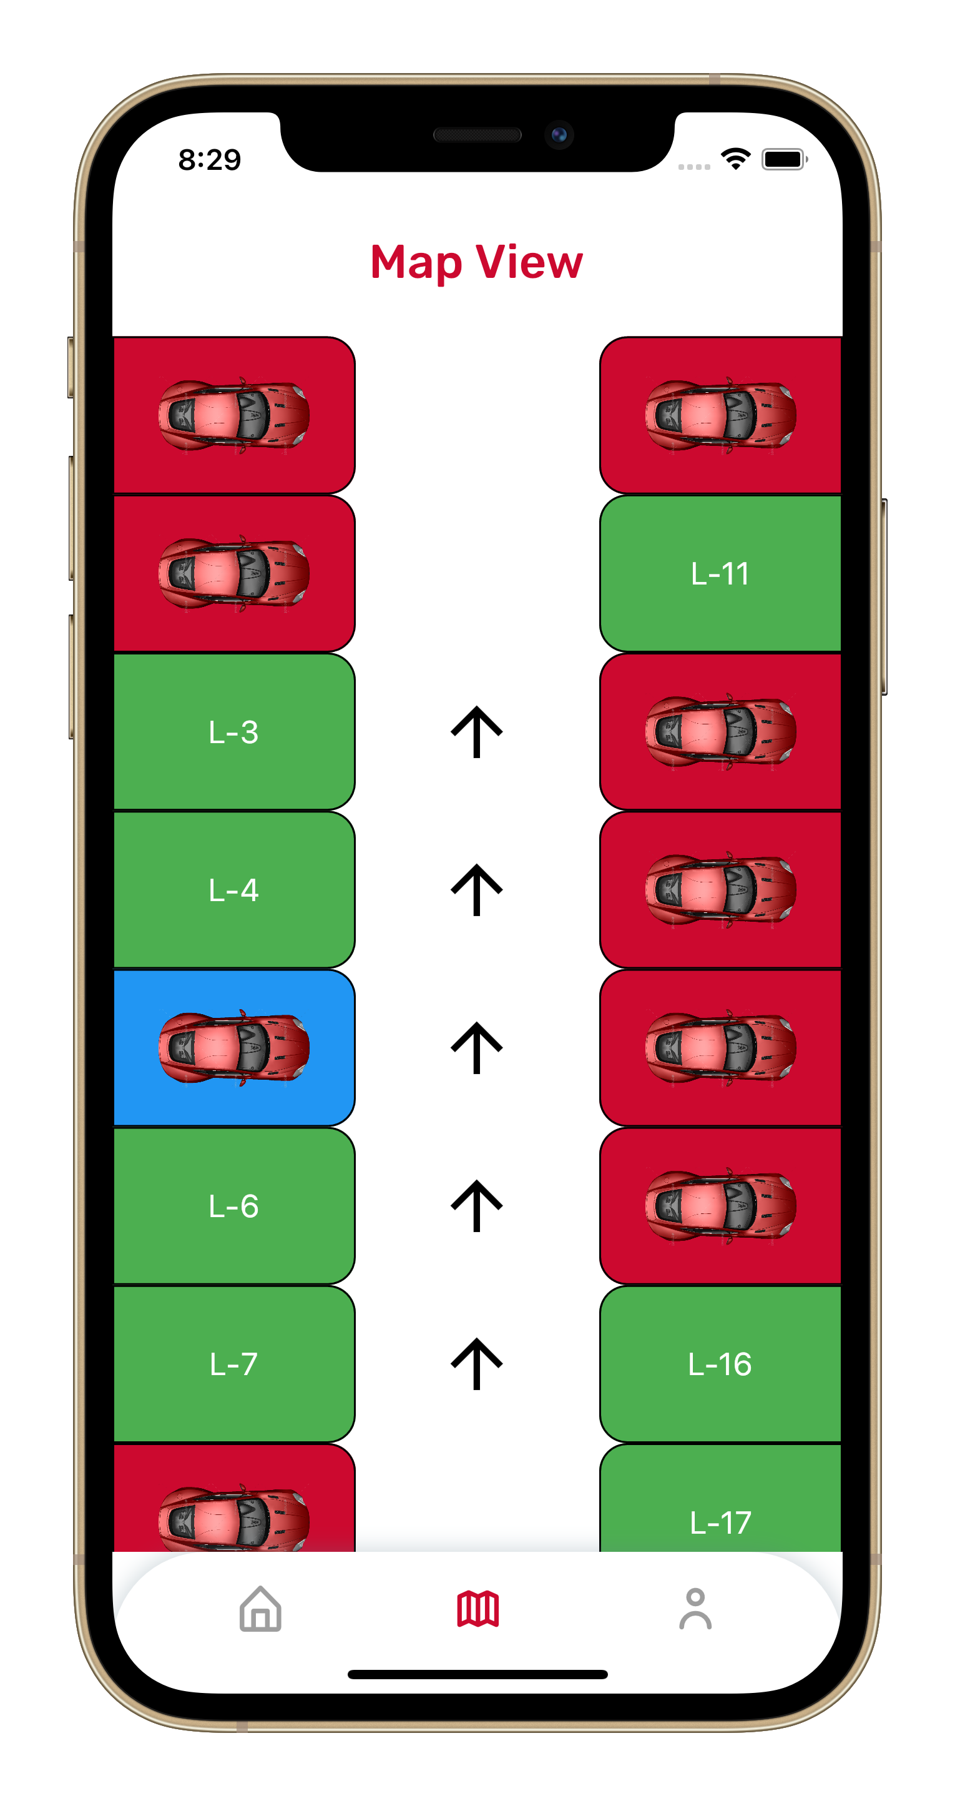
future: FIND MY CAR
Map view mode was integrated with the Find My Car feature that the user can locate their car quickly with the color indicator (Blue), using the collected parking location.

Slide 20
references
[1] Raspberry Pi. https://en.wikipedia.org/wiki/Raspberry_Pi
[2] TensorFlow Lite. https://www.tensorflow.org/lite/
[3] Almeida, Paulo & Soares de Oliveira, Luiz & Jr, Alceu & Jr, Eunelson & Koerich, Alessandro. (2015). PKLot - A Robust Dataset for Parking Lot Classification. Expert Systems with Applications. 42. 10.1016/j.eswa.2015.02.009.
[4] RESTful API. https://en.wikipedia.org/wiki/Overview_of_RESTful_API_Description_Languages API Description Languages - Wikipedia
[5] Node.js. https://nodejs.org/en/js
[6] JavaScript Programming Language. https://en.wikipedia.org/wiki/JavaScript
[7] SQLite3. https://www.sqlite.org/index.html
[8] Flutter. https://flutter.dev/
[9] Dart. https://dart.dev/
[10] Android. https://www.android.com/
[11] iOS. https://www.apple.com/ios/ios-14/ - Apple

Slide 21

Thank You!

